Slide 1
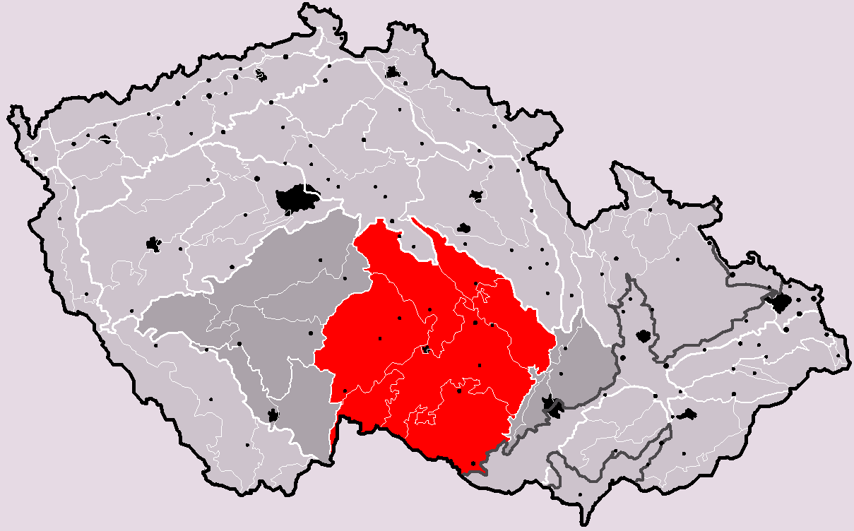
CONSTRUCTION OF NEW NPPs within the context of the state Energy Policy of the Czech Republic and the National action plan for nuclear energy development
Round table discussion and workshop
Třebíč, Vysočina
24. 5. 2017
Presented by Ján Štuller, State commissioner for nuclear energy

Slide 2
State Energy Policy (SEP)
State energy policy is a strategic document which includes state objectives in using energy in line with the principles of the energy security, sustainable development, environment protection and decarbonisation, competitiveness of the economy and acceptability for the public.
The current SEP was approved by the Government in May 2015 and presented to the parliament for information. It was adopted for a period of 25 years.
SEP is binding for the state administration.
SEP is also one of the inputs for preparing regional development plans and policies ☻

Slide 3
State Energy Policy (SEP)
There two main objectives of the SEP:
Security of energy supply to the public and economy under standard conditions:
reliably and safely
for competitive prices
in line with environment protection requirements
Uninterrupted energy supply under emergency conditions in amount necessary for proper functioning of critical infrastructure and functions of the state. ☻

Slide 4
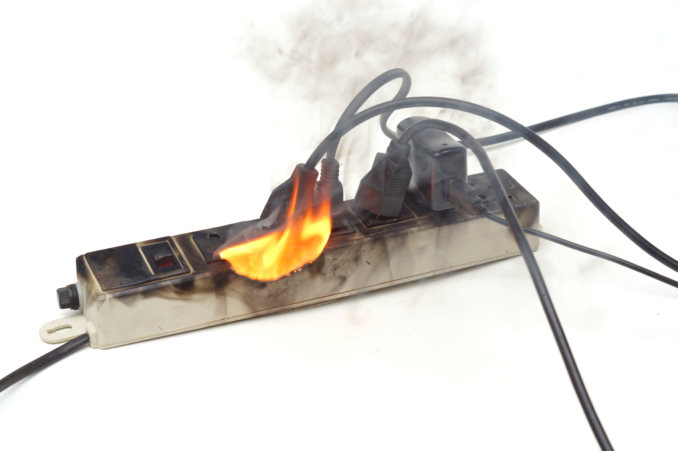
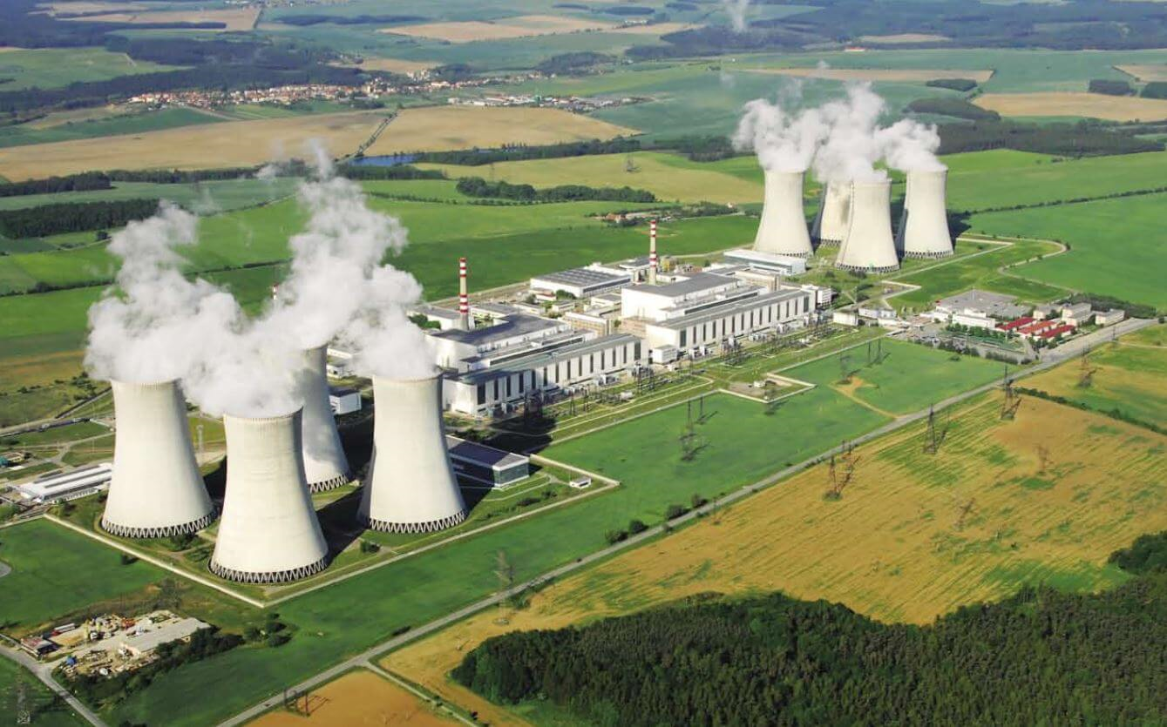
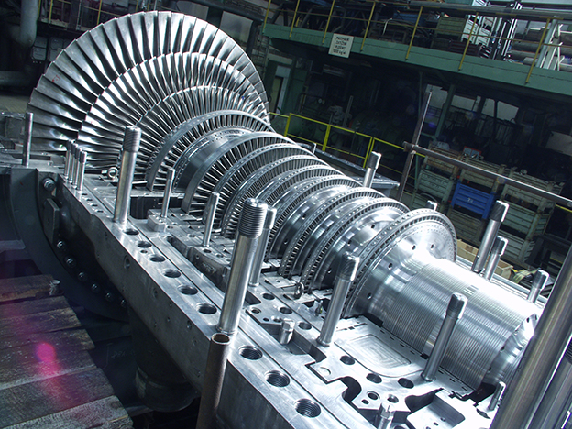
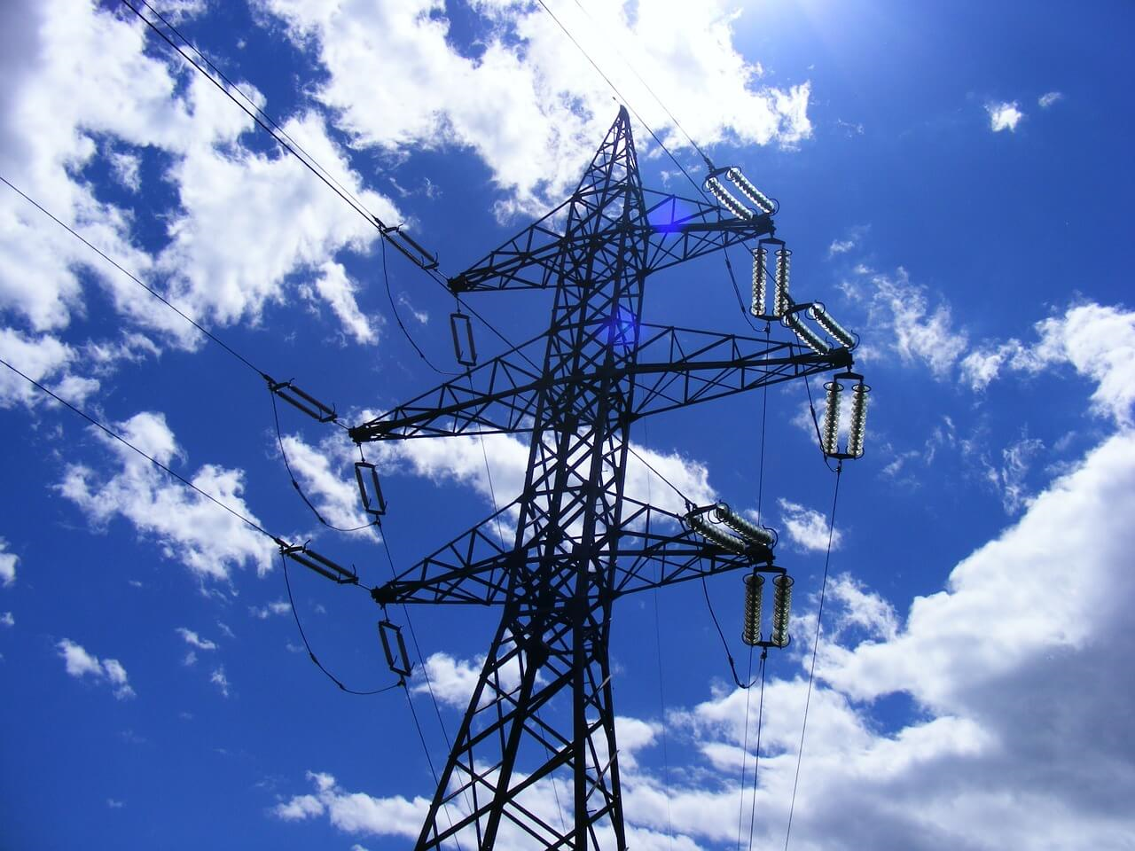
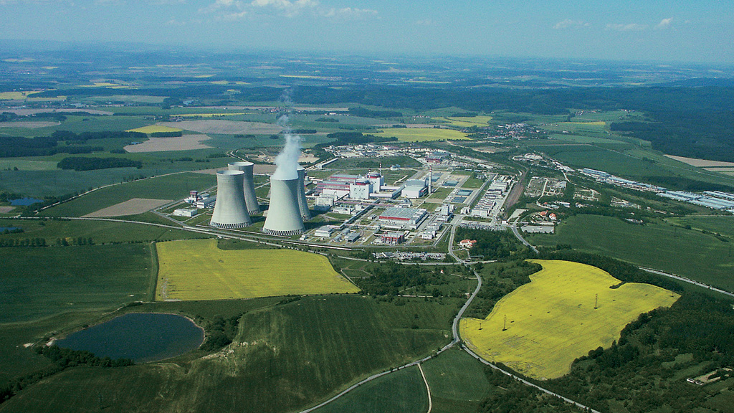
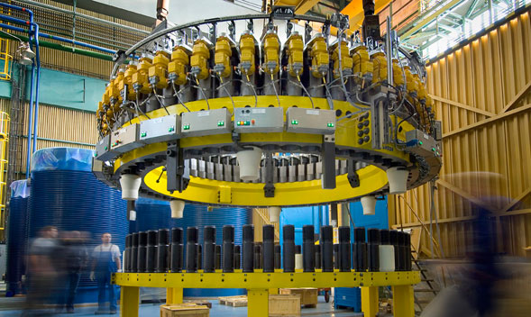
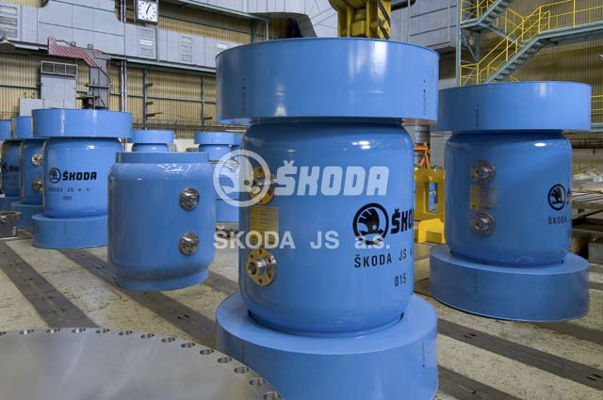
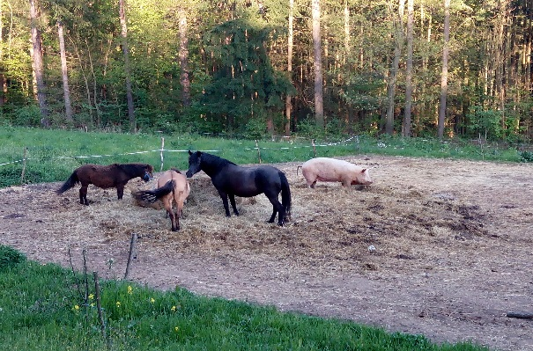
State Energy Policy (SEP)
SEP includes three main priorities :
Environment protection and Sustainability
Energy security and safety
Competitive prices
24/7/365

Slide 5
State Energy Policy
SEP includes:
Strategic goals for energy sector (security of energy supply, structure of the energy mix, targets for emissions, energy savings, etc.)
Optimal scenarios for energy developments ☻

Slide 6
Strengths of the Czech Energy sector
High quality, stability and reliability of energy supply
On-going modernization of the electricity generation and transmission infrastructure
Developed system of heat energy distribution
Full self-sufficiency in electricity and heat generation
Know-how in building complex industrial and technology systems.
Public acceptance of nuclear energy ☻

Slide 7
Weaknesses of the Czech Energy sector
Electricity market deformations and distortion
Limited conditions for renewables
High portion of use of poor quality fossil fuels ☻

Slide 8
national Action plan for nuclear energy development (NAP NE)
On June 3, 2015 the National action plan for nuclear energy development (NAP NE) was adopted by the Government for its immediate implementation. NAP NE was prepared by the Ministry of Industry and Trade in cooperation with the Ministry of Finance.
The NAP NE is based on:
Risk analysis results: high potential for energy deficit in 2035 (or even sooner) if no new (electric) energy sources are built.
Strategic objectives defined by the SEP: maintain energy security based on own reliable and modern electric energy sources (highly reliable, stable – independent on weather conditions, efficient, competitive, environment friendly and acceptable to the public).
Existing experiences and practices:
more than 30 years of experiences in safe operation of NPPs, NPPs being the backbone of the domestic electricity generation (nuclear represents more than 30 % of the overall gross electricity production)
self-sufficiency in electricity production based on renewables only is unrealistic and under current conditions impossible ☻

Slide 9
Národní Akční plán pro rozvoj jaderné energetiky (NAP JE)
Self-sufficiency in electricity production based on renewables only is unrealistic and under current conditions impossible.
NPP Temelin 1,2 (2x 1000 MWe WWER) occupies a surface of less than 1,3 km2
Solar power plant with peak/top power output equivalent of 2000 MWe would cover a surface of 3 300 km2
Wind onshore power plant with peak/top power output equivalent of 2000 MWe would cover a surface of 6 300 km2
Total surface of the CZR = 78 866 km²
Replacement of 4000 MWe by solar power plants would lead to a surface of 6 600 km² (8,4%) and replacement by wind onshore plants would lead to a surface of 12 600 km² (15%), under the conditions of permanent peak/top power output – however the average long term availability in the CZR is around 10%

Slide 10
NAP NE – High risk of energy deficit in 2035 (or even sooner) if no new electric energy sources are built and put in operation by that time
2034 - 2035
Zemní plyn

Slide 11
SEK / NAP NE
The surplus of energy sources will be eliminated due to decrease of coal mining, environment protection restrictions and the end of lifetime of the Dukovany NPP.
The cut in energy sources will not be possible to compensate by increasing the efficiency or energy savings or by using renewables ➔ the only options for compensating the lack of energy sources will be natural gas and nuclear (if no new and more efficient technologies are found).
The use of natural gas has well know shortcomings (lower energy security, higher operational costs and price fluctuations and production of CO2.
Therefore, the only choice is energy mix including nuclear energy.

Slide 12
nAP NE and new NPPs
NAP NE focuses on:
Strengthening the role of the nuclear energy in the electricity generation mix in the CZR, by 2035-2037 replace the oldest units at Dukovany NPP and partially compensate the decreasing production in fissile (coal) power plants => electricity production in nuclear should increase to up to 50% of the gross electricity generation.
Accelerating preparatory activities related to the construction of new nuclear units at existing locations at Dukovany and Temelín with the objective of:
installing new capacity of up to 2 500 MW (respectively with the annual production of around 20 TWh) by 2034-2035 (2037)
providing priority to Dukovany site (so as to compensate on time possible shutdown of Dukovany NPP in 2035-2037).
Maintaining the safe operation of Dukovany NPP and Temelín NPP up to 50 (or 60) years of operation☻

Slide 13
Electricity production in nuclear should increase to up to 50% of the gross electricity generation
Hard coal
Nuclear
Brown coal/lignite
Natural gas
Renewable
Industrial and communal Waste
Oil products

Slide 14
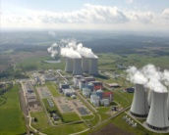
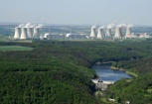
NAP NE - Accelerating preparatory activities related to the construction of new nuclear units at existing sites
Dukovany
Construction of Unit 5 and 6
Pressurized Water Reactor (PWR)
NAP NE also includes plans for searching new sites for NPPs.
Temelín
Construction of Units 3 and 4
Pressurized Water Reactor (PWR)

Slide 15
nAP NE and new NPPs
Three possible investment models are discussed in the NAP NE:
Investment by the current operator and holder of the relevant assets - ČEZ, a. s., (construction costs would be covered solely by ČEZ, a. s. or by its 100% owned daughter org. specifically created for that purpose),
Investment by a consortium of investors, consortium would include ČEZ, a. s., and additional investment partners,
Investment by the state (by a state owned company created for that purpose)☻

Slide 16
nEP NE and new NPPs
NAP NE also recognizes:
Need to establish a Standing Nuclear Committee to oversee further preparation and implementation of policy measures and implementation of the NAP NE and to bring to the attention of the Government issues which require Cabinet attention and action - done in January 2016.
Need to establish expert Working Groups to support the Standing Nuclear Committee (to carry out analytical activities and prepare proposals for implementation in support of the NAP NE) – done in January 2017.
Need to appoint the State Commissioner for nuclear energy (Special Envoy for Nuclear Energy) to monitor the implementation of the NAP NE, inform in early stage the Standing committee and cabinet members on discrepancies and obstacles and propose remedial measures - done in June 2016. ☻

Slide 17
Implementation of the NAP NE
Ministry of Industry and Trade (MTI) interaction with possible suppliers and partners
In July 2016 the MIT sent to 10 companies (potential suppliers of the new NPPs) a Request for Information (RFI). In response the first parts of information packages (IP) related to investment and financial issues were sent to the MIT in September 2016 and the second parts of the IPs including NPP technical data were sent to the MIT in October 2016.
This process was not a start of a selection process, these were not selection activities! Obtained information was helping and supporting the Czech side to consolidate its understanding of the situation in the investor sector and was helping the experts to prepare optimal investment and financing models for Government approval.

Slide 18
Implementation of the NAP NE
Structure of the RFI:
Chapter 1-6 Introduction (generic information)
Appendix A Financial a Commercial Issues
Appendix B Plant Description
Appendix C Plant Data
Appendix D, E Drawings

Slide 19
Potenciální dodavatelé NJZ a jejich projekty
10 potential suppliers were approached
AREVA, ATMEA, CGN, CNNC, KHNP, KEPCO, MHI, ROSATOM, SNPTC and WESTINGHOUSE.
Company | Type/Technology | Logo
AREVA NP, EDF - France | EPR
ROSATOM - Russia | MIR 1200
 | TOI
 | VVER 1500
WESTINGHOUSE ELECTRIC COMPANY Japan/USA | AP1000
MITSUBISHI HEAVY INDUSTRIES, LTD - Japan | EUAPWR1700
ATMEA, France + Japan | ATMEA1
KEPCO, KHNP (Korea Hydro Nuclear Power) | APR1400
 | APR1000+

Slide 20
10 potential suppliers were approached (cont.)
Company | Type/Technology | Logo
China General Nuclear Power Corporation (CGN), China | HPR1000
State Nuclear Power Technology Company (SNPTC), China | CAP1400
China National Nuclear Corporation (CNNC), China | ACP1000

Slide 21
6 companies answered and sent relevant info packages
ATMEA, EDF, CGN, KHNP, ROSATOM and WESTINGHOUSE
Company | Type/Technology
ATMEA, France + Japan | ATMEA1
EDF - France | EPR
China General Nuclear Power Corporation (CGN), China | 1000 MWe
KHNP (+KEPCO) | APR1400
 | APR1000+
ROSATOM - Russia | MIR 1200
WESTINGHOUSE ELECTRIC COMPANY | AP1000

Slide 22
Implementation of the NAP NE
Current operator and holder of the relevant assets, ČEZ, a. s.
In May–July, ČEZ created two daughter organizations - special purpose vehicles (SPV); one for new builds at the Dukovany site and one for new builds at the Temelin site. At present these two SPVs are 100% owned by ČEZ, a. s.,
On July 20, 2016, ČEZ, a. s. initiated the EIA process for Dukovany 5,6 by submitting relevant information to the Ministry of Environment. The EIA for Temelin 3,4 has been completed in 2013
Documentation for site approval for Dukovany 5,6 is under preparation. Site approval for Temelin 3,4 was issued in 2014. ☻

Slide 23
Implementation of the NAP NE
What is next?

Slide 24
NAP NE – installing new capacity of up to 2 500 MW by 2034-2035 (2037 ?)
Decision to further develop nuclear energy sector – NAP NE
Start of operation of the new units
Construction permit for the new units
2025 - 2027
Year
2015
2035 - 2037

Slide 25
nAP NE and new NPPs
NAP NE envisages following steps and activities to be completed:
before 2025:
Decision by the Government on Investment model and financing model (2017-2018)
Complete the EIA process for EDU 5,6
Selection of the NPP supplier
Site and construction licensing processes
Obtaining site and construction licenses for two units at each site
----------------------- HOLD POINT -----------------------
after 2025:
construction of one to four new units depending on electricity needs and electric power of the new units ☻

Slide 26
NAP JE – i přes zpoždění, je Splnění HARMONOGRAMU K ROKU 2035 MOŽNÉ
Činnost / Milník | Poč | Kon | 2015 | 2016 | 2017 | 2018 | 2019 | 2020 | 2021 | 2022 | 2023 | 2024 | 2025 | 2026 | 2027 | 2028 | 2029 | 2030 | 2031 | 2032 | 2033 | 2034 | 2035 | 2036 | 2037 | 2038 | 2039 | 2040 | 2041
Materiál dle NAP schválen vládou | 06/2015 06/2015 | 02/2018 02/2018
EIA | 01/2015 01/2015 | 11/2018 12/2018
Výběr EPC dodavatele | 03/2018 03/2018 | 09/2023 06/2022
Povolení k umístění | 01/2017 01/2017 | 12/2021 12/2021
Územní rozhodnutí | 02/2024 02/2020 | 08/2027 08/2023
Povolení k výstavbě | 06/2024 09/2022 | 11/2029 11/2026
Stavební povolení | 01/2028 01/2024 | 09/2031 02/2028
Dopravní trasa připravena | 09/2016 09/2016 | 02/2033 11/2029
PS připravena na připojení elny |  | 09/2037 09/2033
První betonáž jaderného ostrova | 09/2031 02/2028 | 02/2033 11/2029
Výstavba a spuštění bloku 1 (PAC) | 09/2031 02/2028 | 09/2039 09/2035
02/2018
12/2018
06/2022
12/2021
08/2023
11/2026
02/2028
11/2029
09/2033
11/2029
09/2039
09/2035
Optimální HMG Kritická cesta
Optimální HMG Mimo kritickou cestu
Aktuální reálný HMG

Slide 27
THANK YOU FOR YOUR ATTENTION

